Slide 1

Strategic Alliance: Evaluating Magist Partnership
by Anthony Siarkiewicz, Katharina Gerhardt, Tobias Steinbach and Vensan Mazmanyan

Slide 2

Brazilian market: a growing opportunity for expansion
1
Biggest e-commerce market on continent
2
Large customer base
3
Potential for expansion
source: https://eurotext.de/en/blog/e-commerce-in-brazil/​

Slide 3

Main questions
1
Tech products compatibility
2
Delivery performance
3
Infrastructure Coverage
4
User Reviews

Slide 4
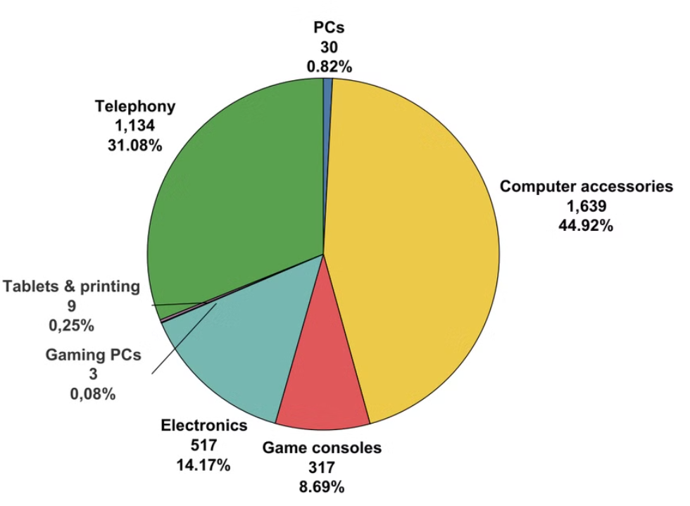
High end tech products
Computer accessories
Electronics
Game consoles
Gaming PCs
PCs
Tablets & printing
Telephony

Slide 5
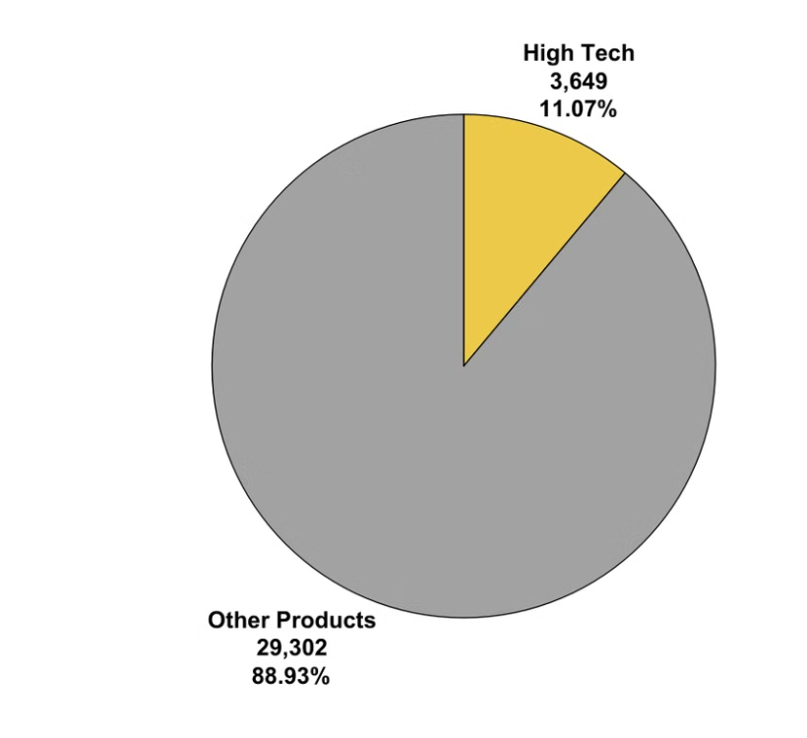
High tech products vs. other categories sold at magist

Slide 6
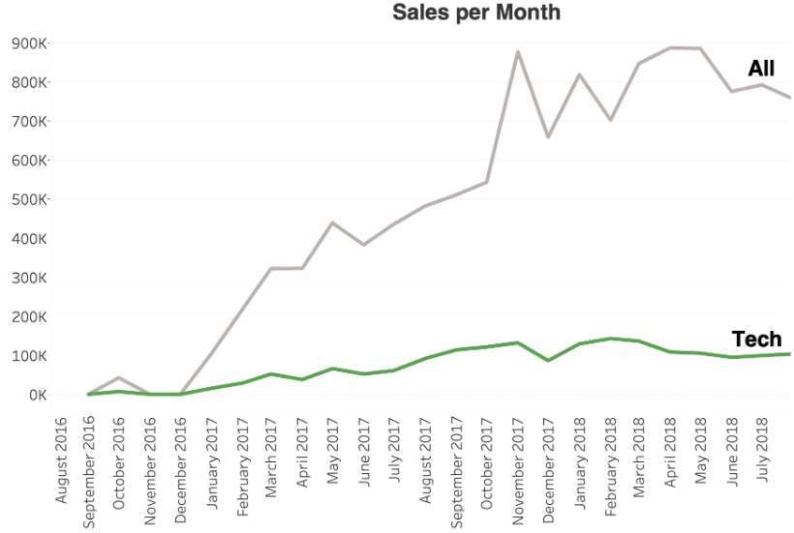
Steady sales trend for tech products

Slide 7
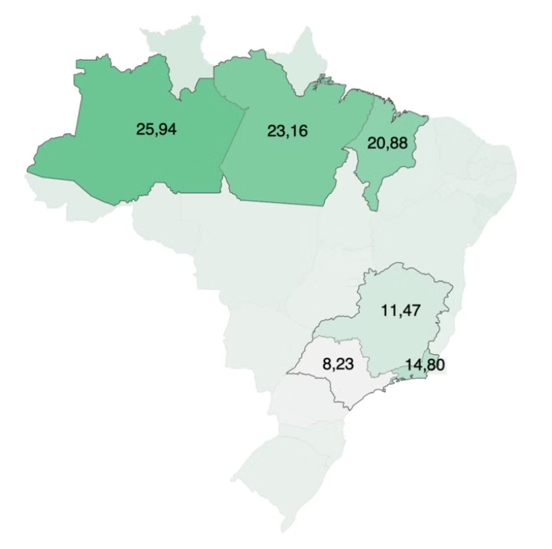
Average delivery times of Magist
Delivery times vary across Brazil
Depending on remoteness of region
longer times in remote North-West
shorter times in populated South-East (Rio de janeiro, Sao Paolo)

Slide 8
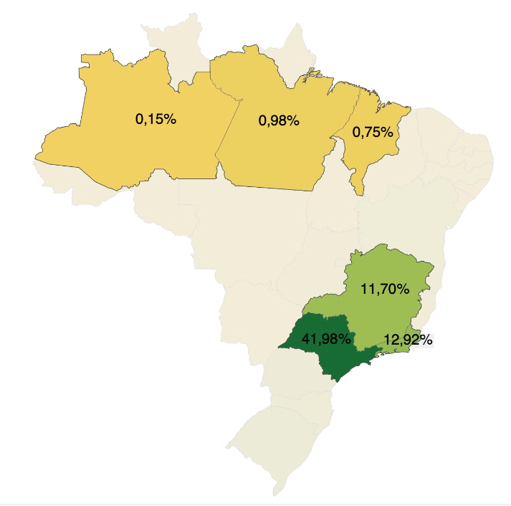
Dispersion of tech-orders throughout states
Nationwide coverage
Mostly to South-East
Orders in well infrastrctured regions

Slide 9
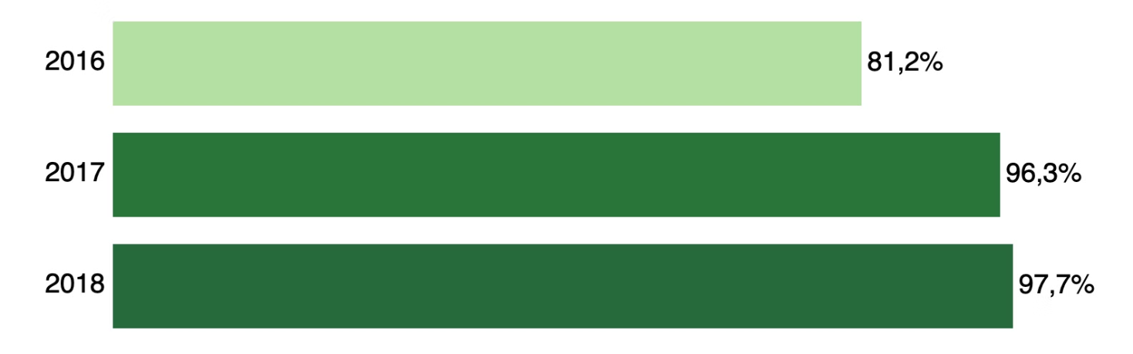
Magist's Delivery Performance: Big Progress from 2016 to 2018
Delivery ratio (delivered / total orders)

Slide 10
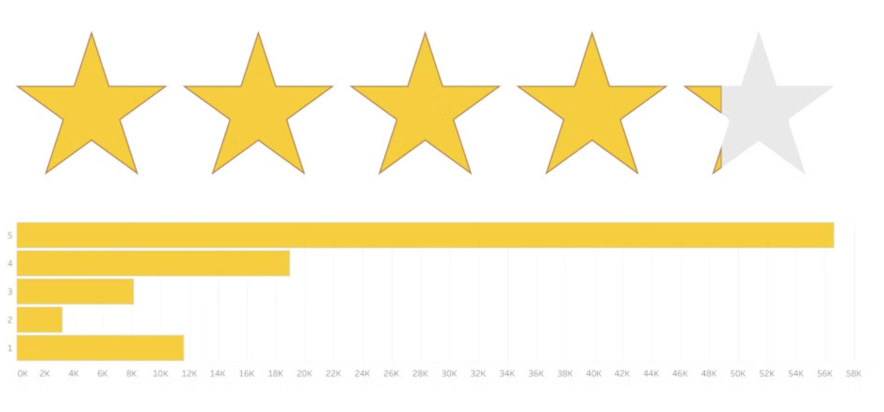
Customer satisfaction average 4.1 stars

Slide 11

Final Conclusion
Pilot project for 3 years
Magist's key strenght in infrastructure
Establish presence in Brazil

